Slide 1
Something for Transforms”
to
EMPOWER BUSINESS USERS TO PERFORM MAPPING OPERATIONS
( Sponsored Project MS-IDC )
Guided by : Ashish Krishna(MS-IDC)
Prof Pramod Khambete(IDC)

Slide 2
Stage 1
Study System
User Studies
Understanding process
Focus area
Scenario
Stage 2
High level concepts generation
Back-Staging Exercise
Content Detailing
Stage 3
Interface Concepts
Paper / Soft-Static-Prototyping
Evaluation of Concepts
Stage 4
Final Concept
Interface Detailing
Usability Evaluation
Blend Prototyping
User Testing
Refined Designs
Biztalk/AppFabric/mapper
Am I on the right track?
Where can I contribute as a Designer?
Learning Blend
2 months
1 month
1 month
1.5 months
finding the process of mapping
evolved process map
Notes:
Get to it.

Slide 3
Study BizTalk- Transforms
Notes:
SCENARIO TO SHOW ACTUAL USER INTERACTION

Slide 4
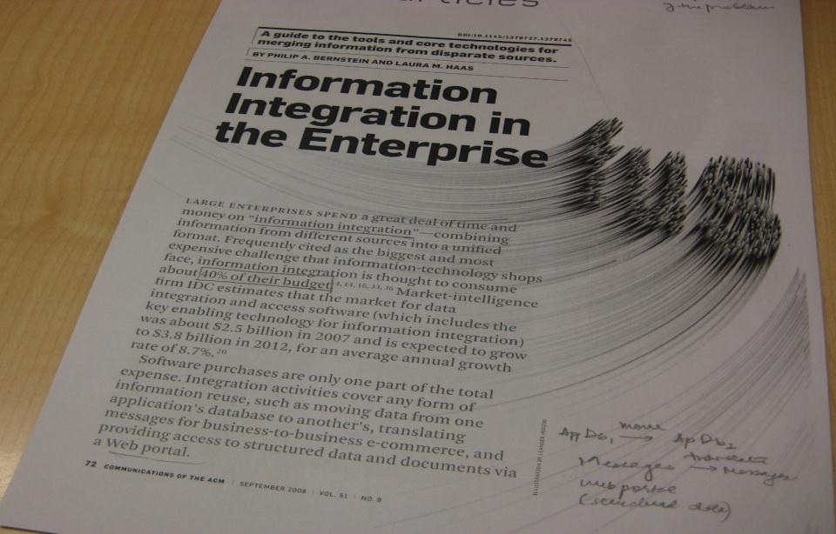
domain study
secondary research

Slide 5
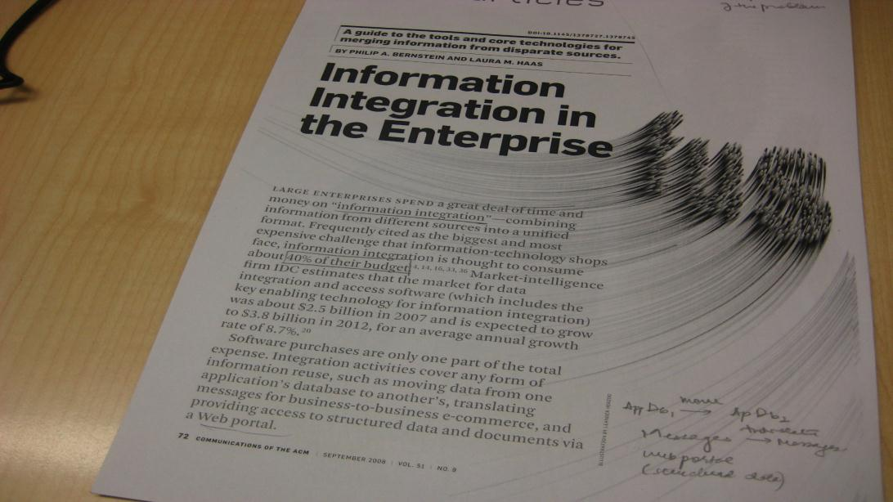
Integration
Message Mapping : EAI
Object-to-Relational Mappers : db
Virtual Data Integration: EII
Semantic Integration
Integration Patterns: Mediation & Federation
Notes:
Tried to understand what integration is which includes message mapping, the new field of semantic mapping, and 2 major integration patterns called the Mediation and Federation. And these can be accessd synchronously or asynchronously with short or long life.

Slide 6
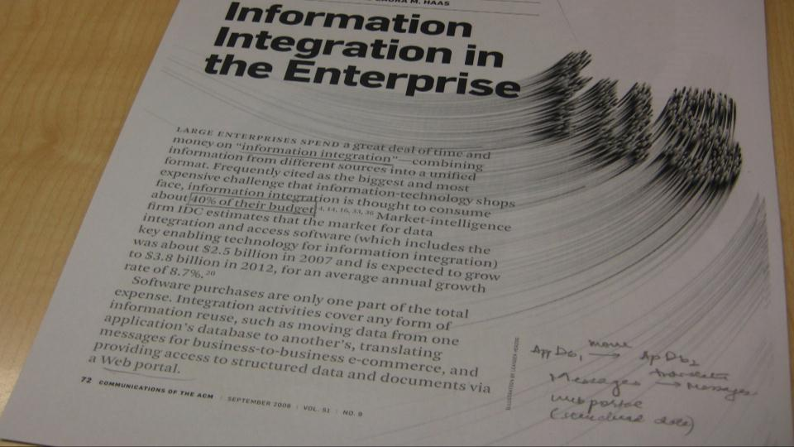
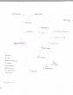
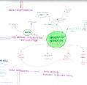
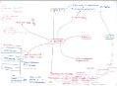
XML, Schema Standards, EDI ,AS2 , Data Cleansing, Schema Mapping, Keyword Search,
UIR Information Extraction,
Dynamic Web , Technologies, Schema Matching, Integration, TPM, Accelerators,
Access patterns
Notes:
I tried to learn all the terminology,

Slide 7
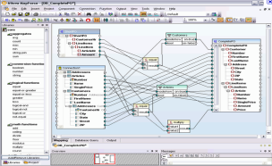
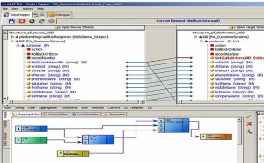
Market Research
Adeptia Integration Suite
Altova MapForce
Apache Synapse
Artix
BizTalk Server
Blackbird ESB
Business Integration Server
FUSE ESB
iBOLT IS
TIBCO
IBM WebSphere
WebLogic
Guarana DSL
ETL
APATAR
Gives flexibility but adds a lot of randomness
Works with nodes and arrows
Very restrictive, no flexibility
Works with nodes and arrows
Notes:
Most of the integration softwares work with the help of nodes and characters like Biztalk mapper does. Atova gies a lot more flixibilty but at the same time it also adds randomness.whereas adeptia doesn give much flexibilty.

Slide 8
problem area
Notes:
MAKE THIS SLIDE AGAIN

Slide 9
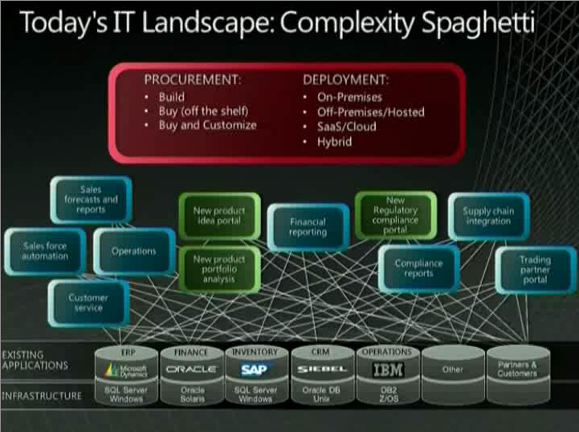
Ref: Sriram's talk
(Microsoft Platform Vision: Road to Agility)
Notes:
This is one of the slides from Srirams talk on “Road to Agility” where he has tried to explain the audience what is the big picture of IT world.

Slide 10

Operating system
Database
Security
Front End
Notes:
According to market .Out of all of the above, microsoft is at an advantage because it also provides Os, it also provides its own database, It has its own security applications and the most important, Microsoft has a universal market in front end.

Slide 11
BPA: Business Process Automation
EAI: Enterprise Application Integration
B2B: Business to Business Integration
BPM: Business Process Monitoring
EAI: Enterprise Application Integration
B2B: Business to Business Integration
Connect s/w
Support automation
Connect trading partners.
real-time monitoring
Notes:
When we talk about biztalk we can talk about 4 different scenarios out of the most important are these two

Slide 12
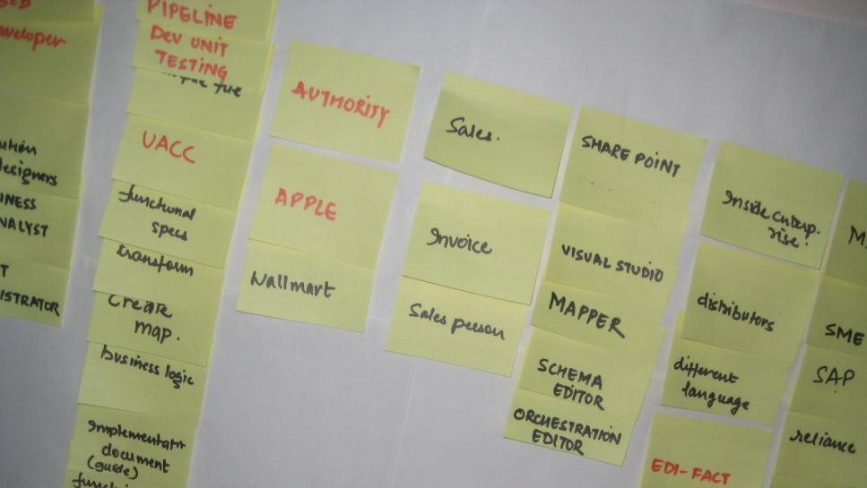
primary research
findings/personas

Slide 13
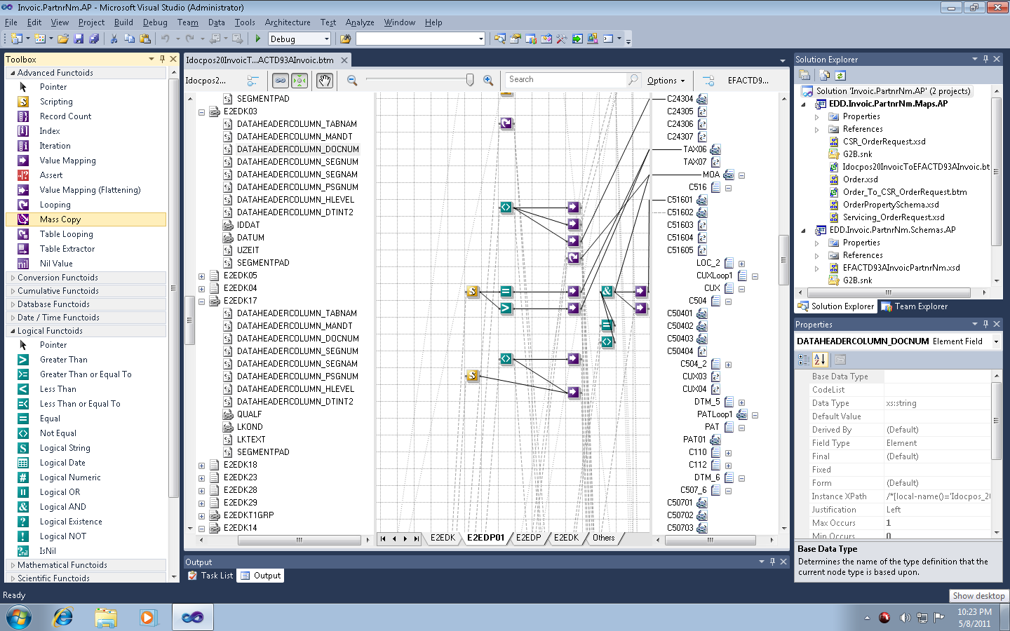
Notes:
This is what I am designing for. And my users are around it

Slide 14
Users
Business Analysts
Solution Delivery Managers
Program Managers
Developers
Testers

Slide 15



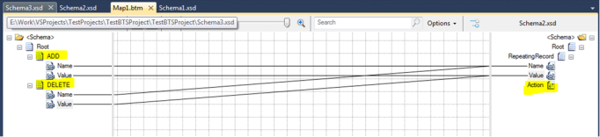
Solution Delivery Managers
Sanket Bakshi ( MCS )
Solution Delivery Managers &
Business Analysts
Business Analyst
Karuppiah A( M-IT )
We have to do same thing three times for documentation
We have tried to do standard format for Functional Spec during Dell project
Most of the times customers know what problem they are facing
There are times where we define the mappings
If we leave things to dev, there are high chance that consistency will break.
Just to add a few details a whole new document needs to be made.
There are a set of mandatory fields for each document.
I would be good if it can be done in Excel

Slide 16
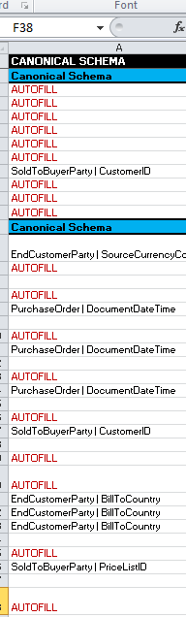

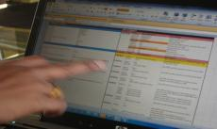
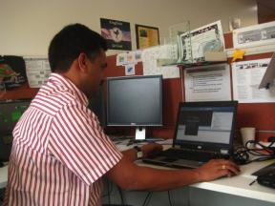

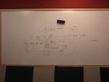
Developer
Amit (MS-IT),
Dipti Sharma (E&D)
Heena Parmar (E&D)
Rajesh
Developer
we do it by referring the Idoc's from SAP
The schema on the destination side is in German so we do not understand the meaning
I get this spec from my manager. I don know what happens before it.
if I spend two hours everyday, It will take a week to complete t his mapping
'AUTOFILL' you wont understand it, it can be understood by us only.
It is very difficult to give KT to TCS if there is some enhancement or bug
It’s a pain to find bug in functoids
We have to map every node of destination schema unnecessarily

Slide 17
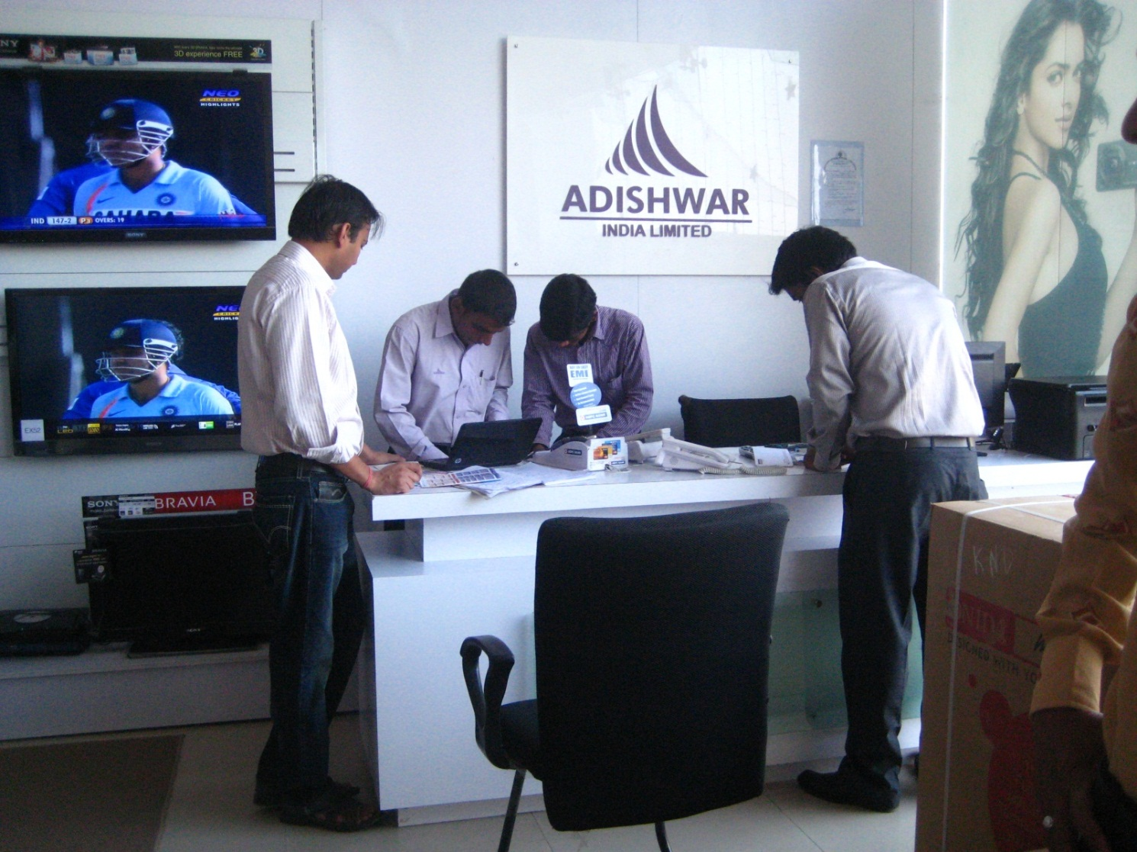
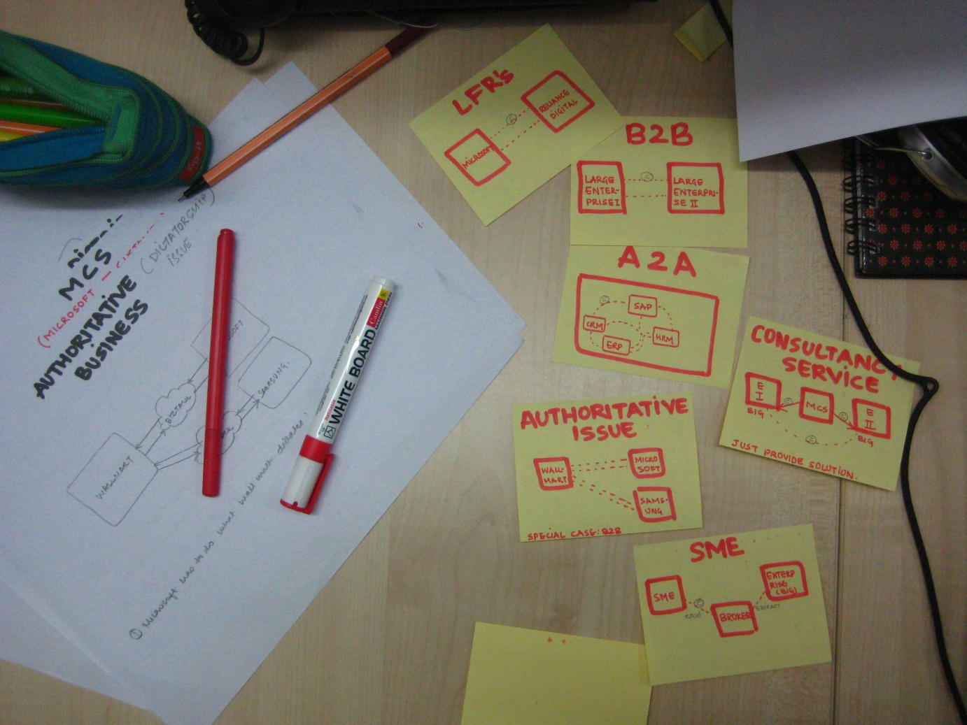

Slide 18
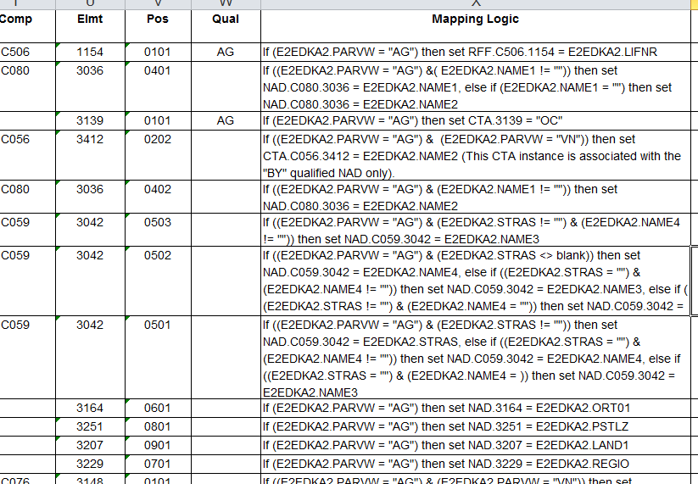
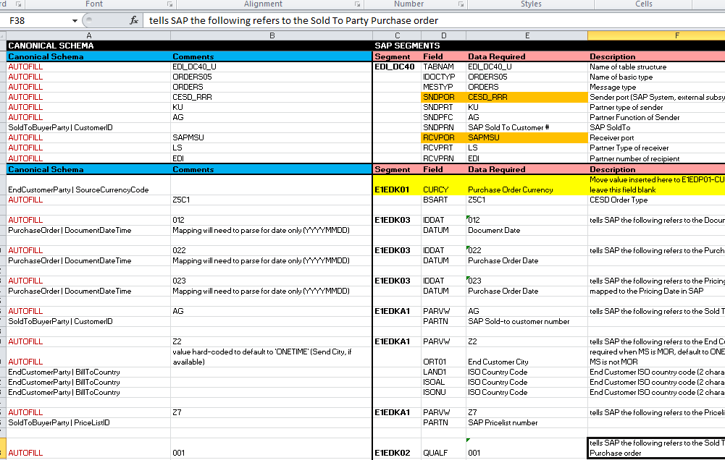
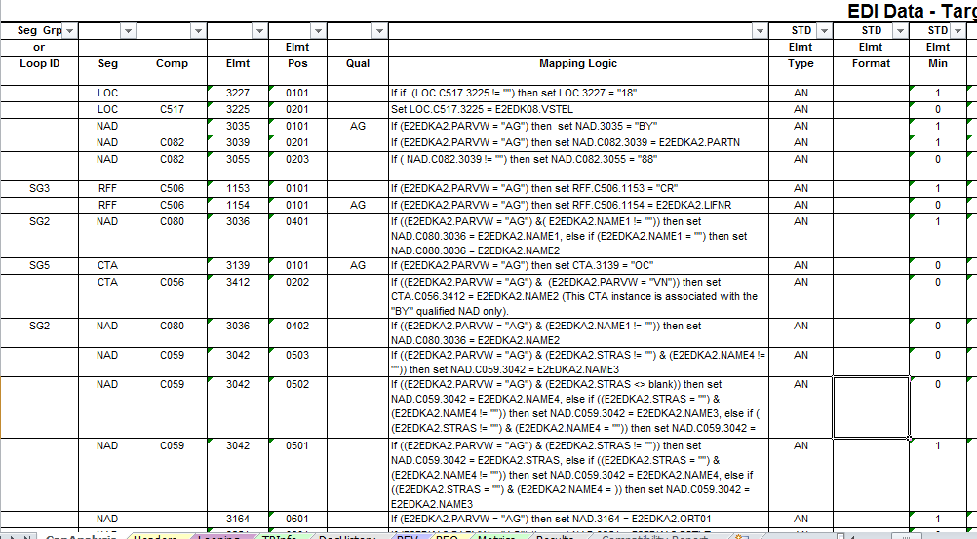
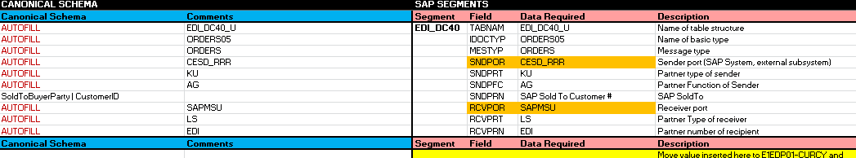

Slide 19
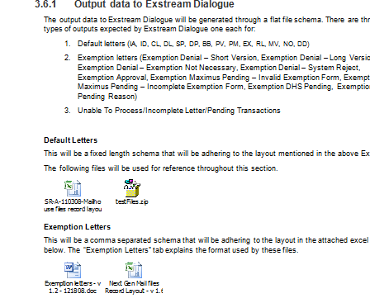
Sanket had More than 100 TS documents just for a single project! Interlinked ! Managed in Folders

Slide 20
task flow
Notes:
SCENARIO TO SHOW ACTUAL USER INTERACTION

Slide 21











Slide 22
‘Quotations’
Tenders

Slide 23
Bids

Slide 24


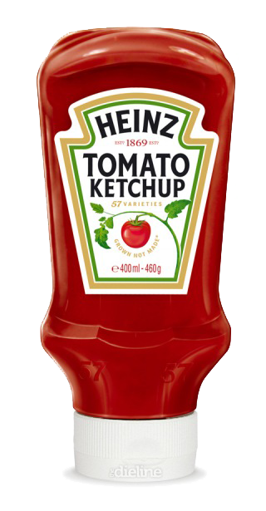
Deal!

Slide 25
What happens after this?

Slide 26






We are Involved
I am the
Marketing
Manager
Business
Analyst
Solution
Designers
Developer
Tester
Administrator
Notes:
In the any transformation scenario majorly 6 users are involved.

Slide 27








Email, HTTP, X.400
Mr. McD
Business Analyst
(Mc Donals)
Mr. Heinz
Business Analyst
(Heinz)

Slide 28


We have a new Trading Partner.
Business Analyst
Can you get me the requirements?
Solution Designer

Slide 29
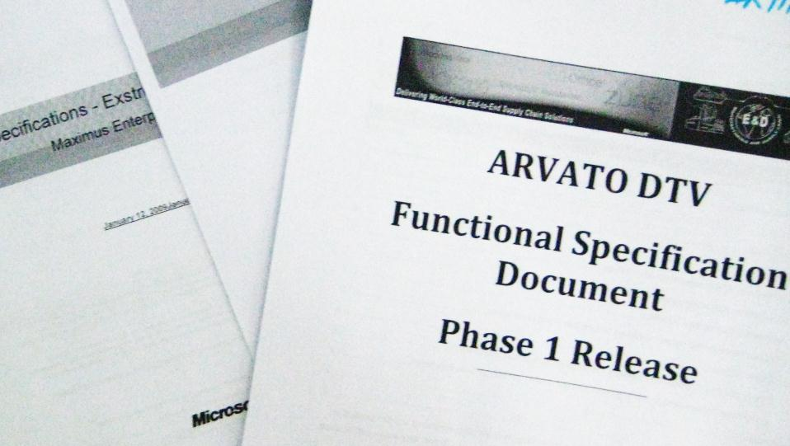

Functional Specs
I would need…
Lets gather the functional specifications.
Business Analyst
I talk only using FTP
I would accept data only in AS2 format
I want you to recieve ACK every 6 hours.
The name should be in FN and LN format
date format, etc
.
.
.
Solution Designer

Slide 30
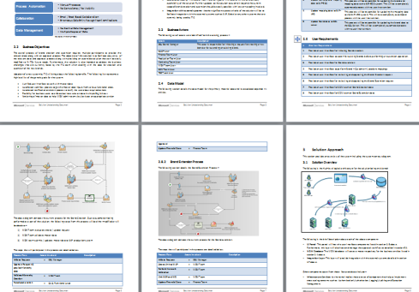
Functional Specs
Business Analyst
We would need a lot of technical changes for this.
Solution Designer
Notes:
N then this guy gets aside and its not the job of the designers

Slide 31
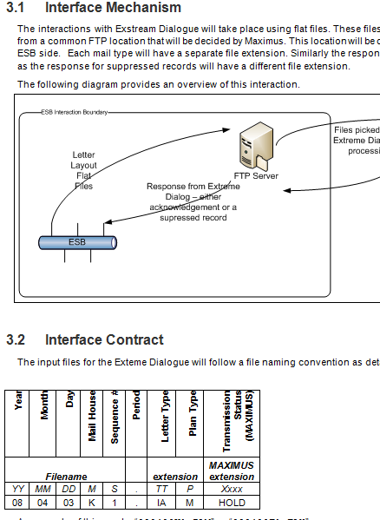
Technical Specs
Business Analyst
You would need to get me the Business Logic to define the rules.
Solution Designer

Slide 32
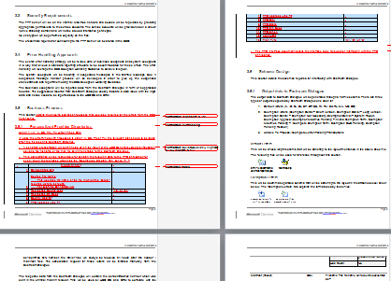
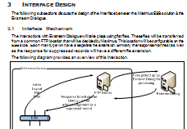


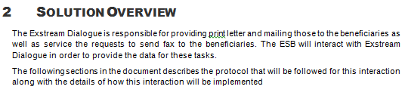
Technical Specs
Business Analyst
Oh no! We again need to write the TS for Developers.
Solution Designer

Slide 33
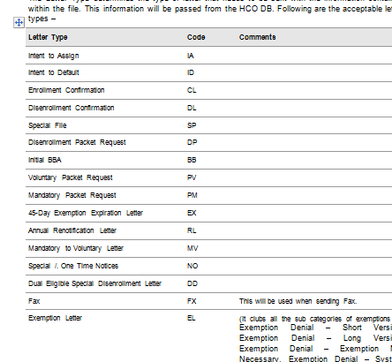
Technical Specs
Business Analyst
Do remember to specify the functoid to be used for mapping. We need consistency. We can’t leave it for dev to decide!
Solution Designer

Slide 34
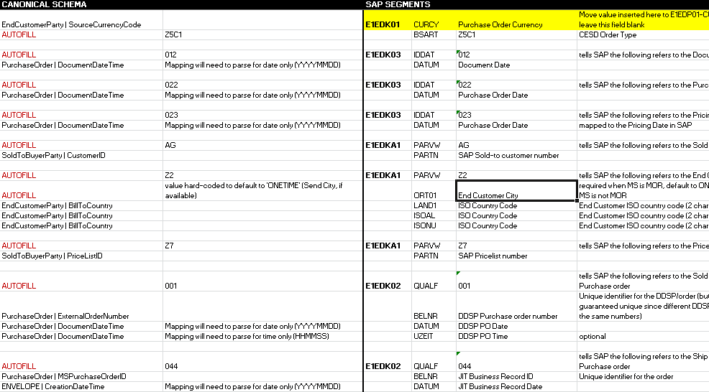
Implementation Guide
Business Analyst
Oh! I also need to make an Implementation Document just for Mapping.
Solution Designer

Slide 35
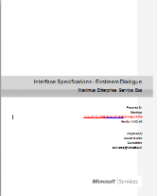
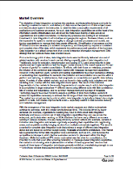
Technical Specs
Business Analyst
Wow! Finally after 2 months the project is ready to go in production.
Solution Designer

Slide 36

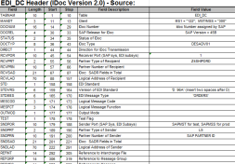
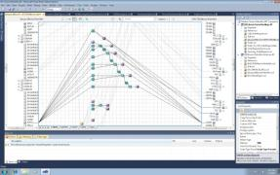
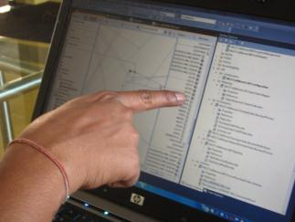

Production
I need the technical document and the Mapping Sheet.
Business Analyst
Developer
Solution Designer

Slide 37
Production
Can you explain me the W27 Mappiing Outbound Requirements?
Business Analyst
Developer
Solution Designer

Slide 38


Production
Finally! The project is ready for deployment. I need to inform the Test team.
Business Analyst
Developer
Solution Designer
Tester

Slide 39
Production
Business Analyst
Developer
Hey, also please give me requirements specs.
Solution Designer
Tester

Slide 40
Production
Business Analyst
Developer
Hey, also please give me requirements specs.
Congratulations! Project is ready for deployment.
Solution Designer
Tester

Slide 41

and the project is successfully deployed
Business Analyst
Developer
Administrator
Solution Designer
Tester

Slide 42
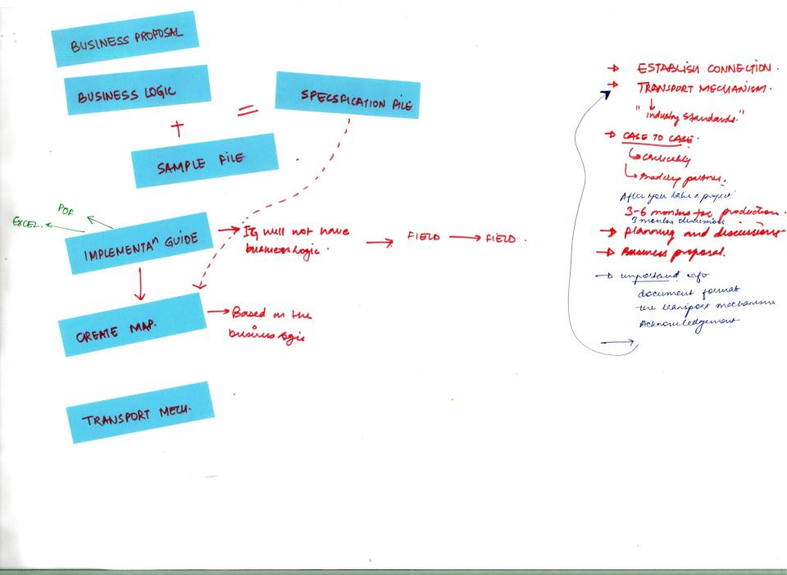
Lets have a look again…
Notes:
Lets again have a look at the document flow that happened to reach mapper.

Slide 43
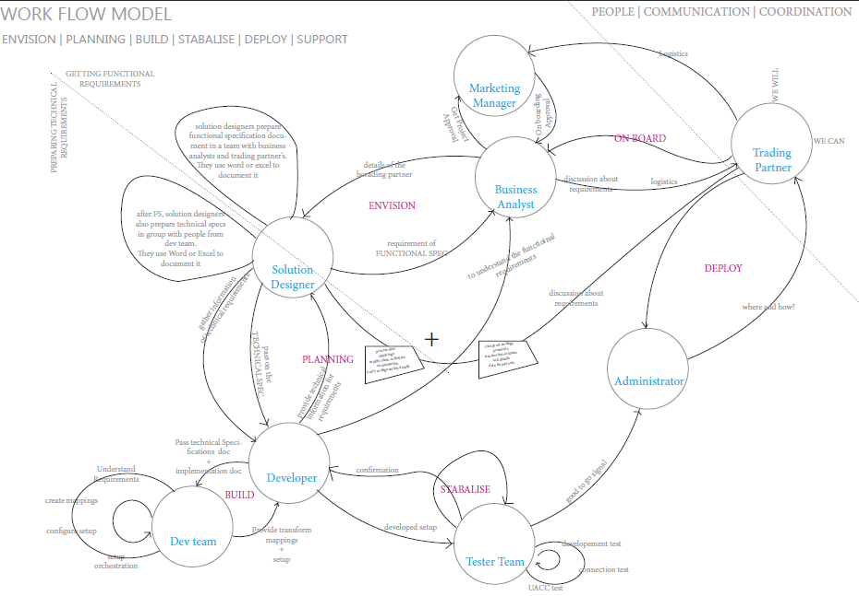

Slide 44



DOCUMENTATION FLOW MODEL AND USER ROLES
Business Proposal
Business Logic
+
Sample File
Functional Specs
Implementation Guide
Technical Specs
Perform Mapping
Notes:
This is the set of documents that transfer in a liner fashion from pre production to production. And the most important is all of them have similar information but diferent format due to no standardisation.

Slide 45
persona: comfort zones
very techie
Word
Powerpoint
Excel
Sharepoint
Mapper
Visual studio and other development tools
Developer
Solution Designer
Tester
non techie
Word
Powerpoint
Excel
sharepoint
Business Analyst
Administrator
Notes:
Our main users are the BA’s the SD’s and the Dev so we shall talk keeping them in main focus.
Out of all MS office is one area on which everyone has a hand on.
It is where all the documents are currently made.
That is what a developer refers to make a mapper in the end.
And it can be one of the potential areas for mapping.
Or something which has capabilites of office but works specifically for mapping and its documentation.
So office or something like that can be star of the game.

Slide 46
opportunity areas
The current process of (BA) Business Analyst gathering information is linear and involves a lot of repetitive work.
Develop a system to enable SME to collaborate to Big Enterprise
Developer unnecessarily understand Business Document to implement of the information gathered and already complied logic by business users (BA + SD + PM)
It is very difficult to do enhancements in the already built mapper.
Users find it very difficult to debug a map once built.
There are no standard formats for documenting the project specifications.
There is no way to collaborate with other project partners other that meetings and conference calls
Business user has all the understood information & he can be used to produce an usable output.
There is no way to manage the documentation.

Slide 47

final brief
Empower Business Users to contribute in the process of mapping implementation.
Design Something that will help business users to contribute in process of mapping and thus reduce redundant work.
collaborative
information gathering
transforms
communicative
mapping

Slide 48
Definitely not this

Slide 49
But how?

Slide 50
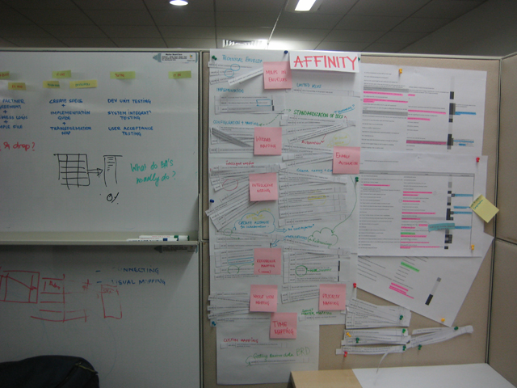
affinity

Slide 51
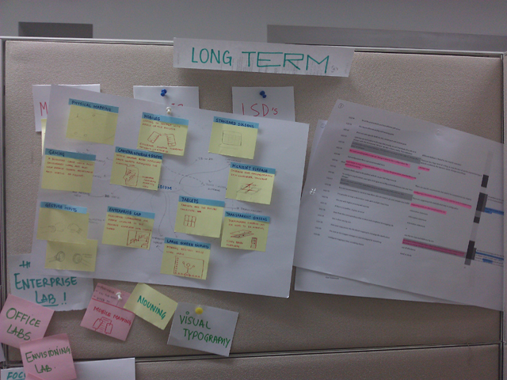
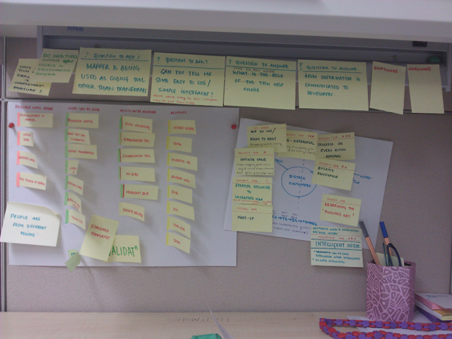
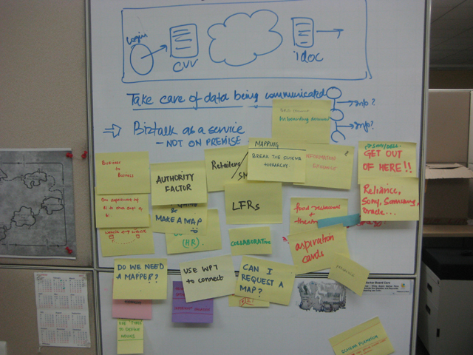
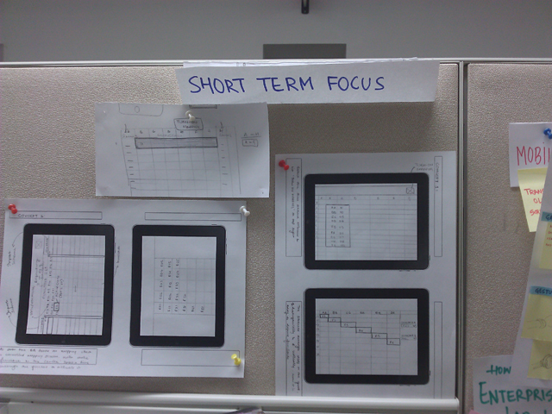
WHERE?
environment user is working in
WHAT?
content user is working
on
HOW?
Interface user is working
with

Slide 52
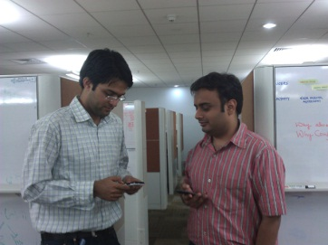
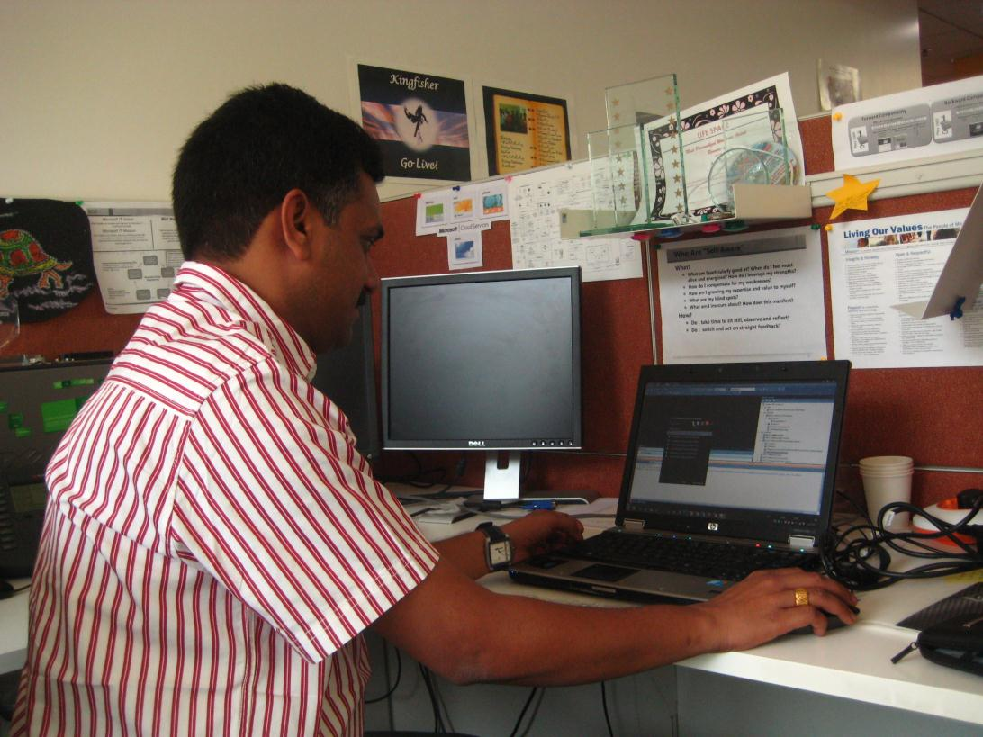


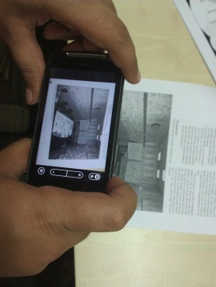


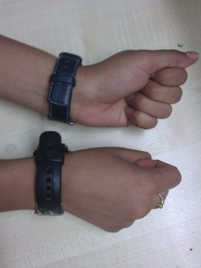
environment
Mobile networking
Large Screen Displays
Surface
Camera on paper
slates
Gesture
mapping

Slide 53
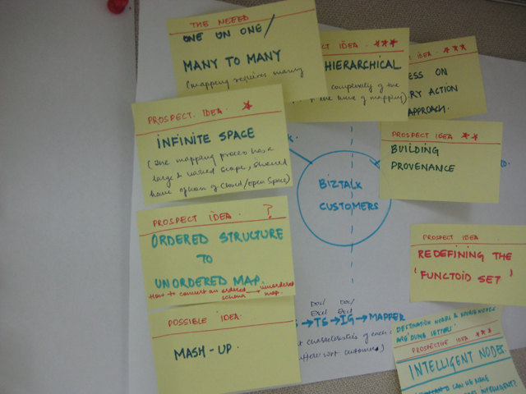
content
Structural Constructs :
chunking the Schemas, H to NH
2. Intelligent Node :
how can getting rid of functoids
3. Enable Provenance : what have I done?

Slide 54
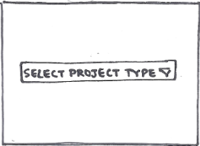












interface level concepts
Wizard mapping
1. Wizard mapping
(Build upon existing)
2. Follow the flow
(Interacting diagrams)
3. Mapbox
doc + mapping toolbox
4. process view mapping
5. Envelops
6. Reference mapping
7. Excel Mapping
Perform mapping operations using excel commands
Follow-the-flow
Mapbox
Notes:
SCENARIO TO SHOW ACTUAL USER INTERACTION

Slide 55
backcasting
Notes:
SCENARIO TO SHOW ACTUAL USER INTERACTION

Slide 56


backcasting
http://www.naturalstep.org/backcasting

Slide 57
backcasting
2020
aclick
Match-Me
Kinecting
Ref from: Ashish
http://www.naturalstep.org/backcasting
2018
Slate Mapping
Voice Mapper
Click-to-Map
2015
Intelligent nodes
Structural Constructs
Whole-view-mapping
2014
2012
Wizard Mapping
map-box
follow-the-flow
1. excelling

Slide 58
backcasting
2020
aclick
Match-Me
Kinecting
http://www.naturalstep.org/backcasting
2018
Slate Mapping
Voice Mapper
Click-to-Map
2015
Intelligent nodes
Structural Constructs
Whole-view-mapping
2014
2012
Wizard Mapping
map-box
follow-the-flow
excelling
Notes:
Hardware is the future

Slide 59
content
Notes:
Show that there are three more documents of the sme type

Slide 60
DOCUMENTATION FLOW MODEL AND USER ROLES
Business Proposal
Business Logic
+
Sample File
Functional Specs
Implementation Guide
Technical Specs
Perform Mapping
Notes:
This is the set of documents that transfer in a liner fashion from pre production to production. And the most important is all of them have similar information but diferent format due to no standardisation.

Slide 61

Notes:
In addition to previous concepts here are few more…

Slide 62
Interface
Paper / Static Prototypes
Notes:
Show that there are three more documents of the sme type

Slide 63
interface level concepts
WizMap
Intellay
Mapic
Excellator
Maplator
Cllop

Slide 64





business invites partners onboard.
Prototype 1: WizMap (Wizard mapping+ follow-the-flow)
Getting approval from partners
importing the business requirement document
Editing business requirements as suggested by SAP
After locking BRD document user moves to Functional Specifications
Notes:
Build on already existing information

Slide 65






Prototype 1: WizMap (Wizard mapping+ follow-the-flow)
User selects OUTBOUND from the interactive workflow
Continue to others parts of the functional document
A workspace is generated which gives a whole view as per trading partners.
user zooms in to one module
Information about the module :
-What is happening there?
-Related Documents

Slide 66



Prototype 2: Intellay
Infinite work space
User Makes the system intelligent with every step
OOPs concept ( Reuse, Inheritance )

Slide 67







Prototype 3: Mapic
Unlock your target

Slide 68

Prototype 4: Excellator
IDEA 1
If we assume the mapping elements are converted to two columns like a table.
User selects ‘MAP IT’ and the information gets transformed to a map.
IDEA 3
As soon the User selects ‘TURN-ON MAPPING’ feature the content on the existing excel sheet transforms to mapping area.
Each box defines a logic.
User has to draw a line through the box to concatenate the logic
IDEA 2
The Schemas arrange themselves on a horizontal and a vertical grid. Define a functoid to define a logic between source and destination
Notes:
If we assume the mapping elements are converted to two columns like a table.
User selects ‘MAP IT’ and the information gets transformed to a map.

Slide 69






Prototype 4: Excellator
Users tool
Mapping toolbar(Domain based)
Example feedbacks

Slide 70





Prototype 5: Maplator
Focus + Context
Natural User Language

Slide 71



Prototype 6: Cllop
Maximum space for schema
Fill in the blanks

Slide 72
Evaluation- Stage 1

Slide 73



evaluation process
concept walkthrough
feedback interview + feedback form
expert review

Slide 74

Schema
Operation
Validation to user
Getting Schemas
Which operation to perform
Searching parameters in schemas
How to perform that operation?
from spec to schema
WizMap
Natural User Language
standard schemas
Example Feedback
Intellay
Online source
Fill in blank
Structural Constructs
Excelator
Maplator
Auto search
Cllop
Concept Evaluation & Findings (with users/pm’s/experts)

Slide 75
final concept

Slide 76
scenario - Before
Notes:
Show that there are three more documents of the sme type

Slide 77

We need to ship the DELL-Work-OrderProcess for test deployment tomorrow.
One fine morning…
8th May 2011

Slide 78

Notes:
Aniket starts preparing the mapping sheet for Rakesh referencing the gathered information.

Slide 79


Slide 80


Slide 81


Slide 82


Slide 83




Oh ! It’s alreadt 5’o clock… !
Notes:
It’s 5 ‘o clock in the evening and the mapping sheet is still not complete.

Slide 84

She must be waiting!
Let me inform her first…
Notes:
Aniket suddenly remember that he has to pick up his wife from the shopping mall.

Slide 85

Finally, the mapping specs is complete !
Notes:
He quickly wraps up the remaining mapping documentation by 5:30 and rushes back home.

Slide 86

Notes:
Aniket sends the mapping implementation sheet to Rakes to proceed to mapping.

Slide 87

All my bags are packed I am ready to go….
lalalalalala…
on the other side…
Notes:
On the other side, Rakesh is waiting for the mapping sheet as he has no information about the the project schemas and specifications.

Slide 88

Notes:
He gets the mapping reference sheet and he is angry as he had nothing to do the whole day long and now suddenly a lot of work has come up..

Slide 89

Its 5:30… If I’ll start it now I barely reach for the movie plan with Ritu.

Slide 90

Let me just complete it quickly !

Slide 91

Rajma is really nice today!

Slide 92

TRING TRING!
TRING TRING!

Slide 93

In the specs you have written ZHR1121 in target but I can find it anywhere in this huge schema I have searched it everywhere!
You have to with the default value. I might have copy pasted the content from the previous cell by mistake.

Slide 94

Sorry Darling that was an urgent call…
It’s OK Ani… Come let’s watch some TV together…

Slide 95

grrrrrrr
TRING TRING!
TRING TRING!

Slide 96

There is a mapping logic that says “IF Set FIELDNAME = 'RP50G-SUBTY‘
Is it conditional loop?

Slide 97

I was thinking….

Slide 98

TRING TRING!
TRING TRING!
Aaaahhhh…
Tum na office main hi raha karo!!!!

Slide 99

☹ Z Z Z Z Z Z Z…..
TRING TRING!
TRING TRING!

Slide 100

The Vodafone Number you are trying to reach is currently switched OFF...

Slide 101

I can’t understand what to do now…!!

Slide 102

Oh! Ritu must be waiting in the PVR !!! Let me wrap as much I know soon
He should be here any minute…Its gonna be so much fun!

Slide 103

The movie has already started… I hate to miss the starting.

Slide 104

SORRY SORRY SORRY SORRY SORRY SORRYYYYYYY!!

Slide 105

We have again missed the deadlines.
NEXT DAY, in the morning…
9th May 2011
THE END.

Slide 106
deliverables
Task Flow
Application

Slide 107


Slide 108
Application User Interface Model
get content
Get Source
Get Target
editing
perform operations
Fill source bucket
Through Target
Fill target bucket
Through Operation
Select Operator
Through Source
Assign to Target
reference back

Slide 109
interface design
Layout
Commands
Elements
Actions
Theme
Icons
Transitions

Slide 110
interface skeleton
Ribbon
Operators
Extended Ribbon
Source
Bucket
Expresset
Target
Bucket
Body
Source
Schema
Map
Target
Schema

Slide 111
interface skeleton
Ribbon
Operators
Extended Ribbon
Source
Bucket
NUL Prompts
Operation Chain
Result Bay
Target
Bucket
Expresset
Expresset
Body
Source
Schema
Map
Target
Schema

Slide 112
interface skeleton
Ribbon
Operators
Extended Ribbon
Source
Bucket
Expresset
Target
Bucket
Body
Source
Schema
Map
Target
Schema

Slide 113












icons

Slide 114
icons
Default view
When Selected

Slide 115
highlighting

Slide 116
transitions

Slide 117

metro

Slide 118
Blend Prototype
Operation Application for testing
Feature Flow
Notes:
Show that there are three more documents of the sme type

Slide 119



usability evaluation : stage II
concept walkthrough
Task Performance
interviews
7 users
Success fullness
Penalty for Error
Adaptability
Time taken
goal: to test the operation performance ability of the user using new interface
Notes:
Show that there are three more documents of the sme type

Slide 120

task sheet

Slide 121

results
Successful-ness : Users could perform the complete set of tasks.
Penalty for Error
Time : Average = 10minutes,10 seconds
Adaptability = observation study
Richness of Interaction Space
 | Time Taken | TASK-1 | TASK-2 | TASK-3 | TASK-4 | TASK-5 | TASK-6 | TASK-7
EUS-1 | 7:40 | 1 | 1 | 2 | 1 | 2 | 2 | 1
EUS-2 | 10:50 | 1 | 1 | 1 | 1 | 2 | 1 | 1
EUS-3 | 11:20 | 1 | 1 | 1 | 3 | 1 | 1 | 1
EUS-4 | 10:50 | 1 | 1 | 1 | 1 | 1 | 1 | 1
Iterations done by user
Task number
Notes:
Show that there are three more documents of the sme type

Slide 122



Some user output screens
Notes:
Show that there are three more documents of the sme type

Slide 123
refined design
Assign operation is an add on to mapping
Operation snippets
It might get complicated with VERY large source and target schemas
usability issues (double click)
Affordances and interactions
Notes:
Show that there are three more documents of the sme type

Slide 124
Scenario - After
Notes:
Show that there are three more documents of the sme type

Slide 125
We need to ship the DELL-Work-OrderProcess for test deployment tomorrow.
One fine morning…
27th May 2011

Slide 126

It’s already 2’o clock…
Let me start doing my work.

Slide 127

hmmmmm, cool !
this new tool also shows me the consequence of the operation I selected…!

Slide 128

It’s Done!
This new mapping tool is really helpful !! I did not just write it, I did it!
Let me see how many I was able to map…

Slide 129

WOAH !!! I am impressed

Slide 130

Oh yeah!
She must be waiting for me…

Slide 131


Slide 132

All my bags are packed I am ready to go….
lalalalalala…
on the other side…

Slide 133

Oh wow! 70 % mapping is already complete… I have to do only 30% !!
“ye to mere bae haath ka khel hai !!”

Slide 134


Slide 135

Janeman Janemann ! Palat teri nazar… yahan hai dil mera… dekhti hai kidhar … hehhe….
Atleast today I will reach on time…
Main aa raha hon Ritu!

Slide 136
Rajma are really tasty today!

Slide 137
Kitne din ho gae na ache se baat kiye…

Slide 138
I was thinking….

Slide 139


Slide 140

Nice Job guys!
NEXT DAY, in the morning…
28th May 2011
THE END.

Slide 141
conclusion
The new proposed task flow will help reduce a lot of redundancy in the project work Flow.
The proposed system can empower business users to contribute in the process of mapping.
Next steps:
Hierarchical structures
Affordances
Mapping status
Tagging
Notes:
Show that there are three more documents of the sme type

Slide 142
thank you
Special thanks to
Ashish Krishna
Deepak Jain
Prof Pramod Khambete
Prof Anirudha Joshi
Arpit Nand
&
my friends and family
Notes:
Show that there are three more documents of the sme type

